Slide 1
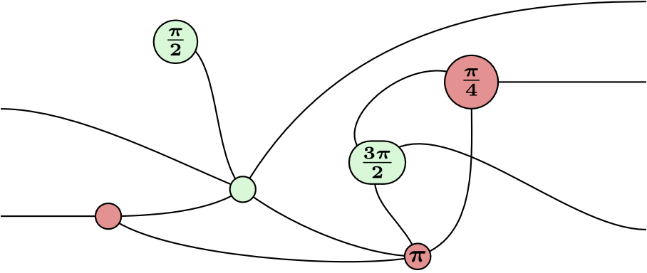
ZX-Calculus
Manuel Lerchner
13.06.2023

Slide 2
What is ZX-Calculus?
A graphical language extending circuit diagrams
Allows breaking up logic gates into smaller atoms
The resulting graph is a low-level representation of the circuit
Using transformations on those atoms we can visually deduce
Properties of circuits
Entangled states
How quantum protocols work

Slide 3
Applications
Quantum circuit optimization
Reduce complexity of circuits
T-count reduction
Important metric for performing fault tolerant computations
Circuit Compilation
Reducing high level quantum algorithms to run on a target architecture

Slide 4
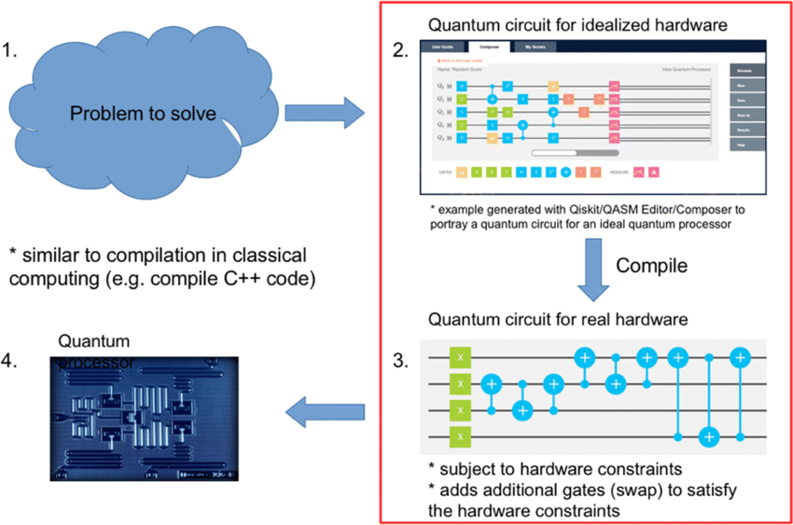
Quantum Circuit optimization
Circuits use many abstract gates
Problems of real quantum computers:
Limited set of gates
Limited connectivity between qubits
Noise
Special circuit transformations
To swap qubits, so they can be entangled
Reduce depth of circuit (noise issues)
Allow only some set of gates
ZX-Calculus can solve this
Can try to stick to those rules during the reconstruction phase

Slide 5
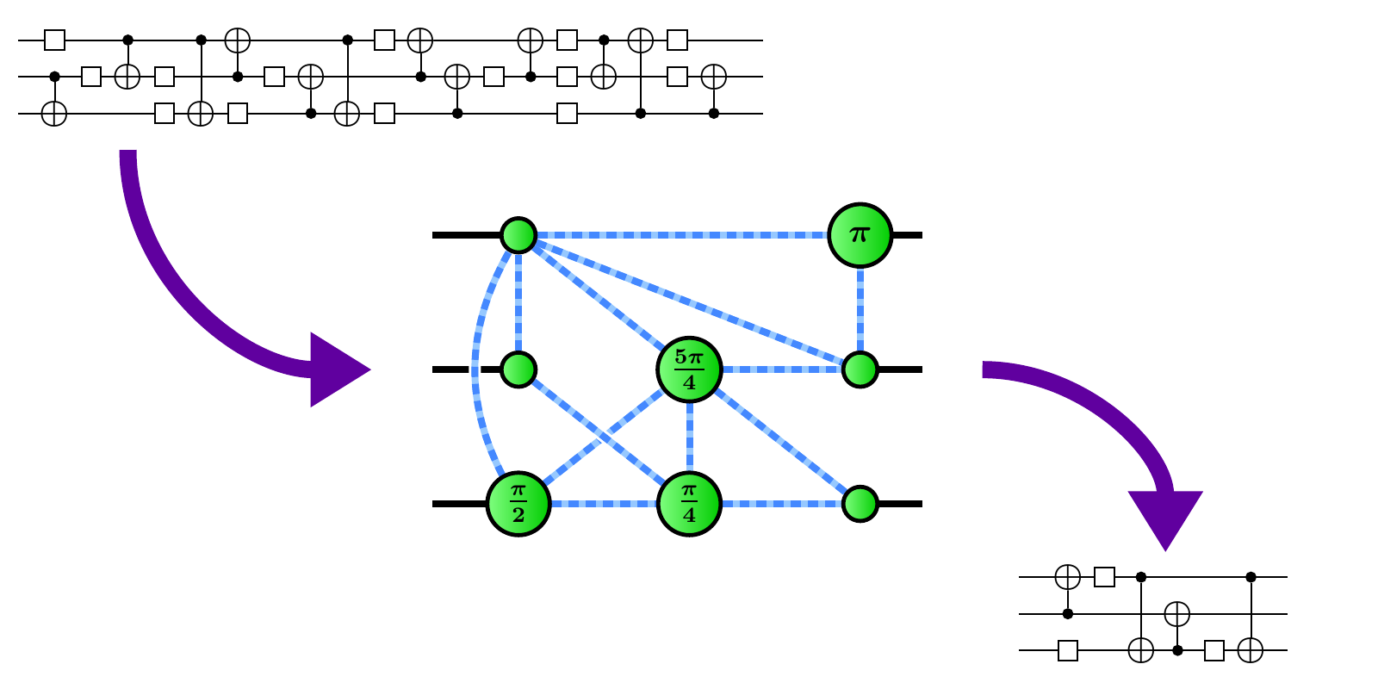
Quantum Circuit optimization
Goal: Transform circuits into equivalent circuits
New Circuit must have fewer / simpler gates

Slide 6
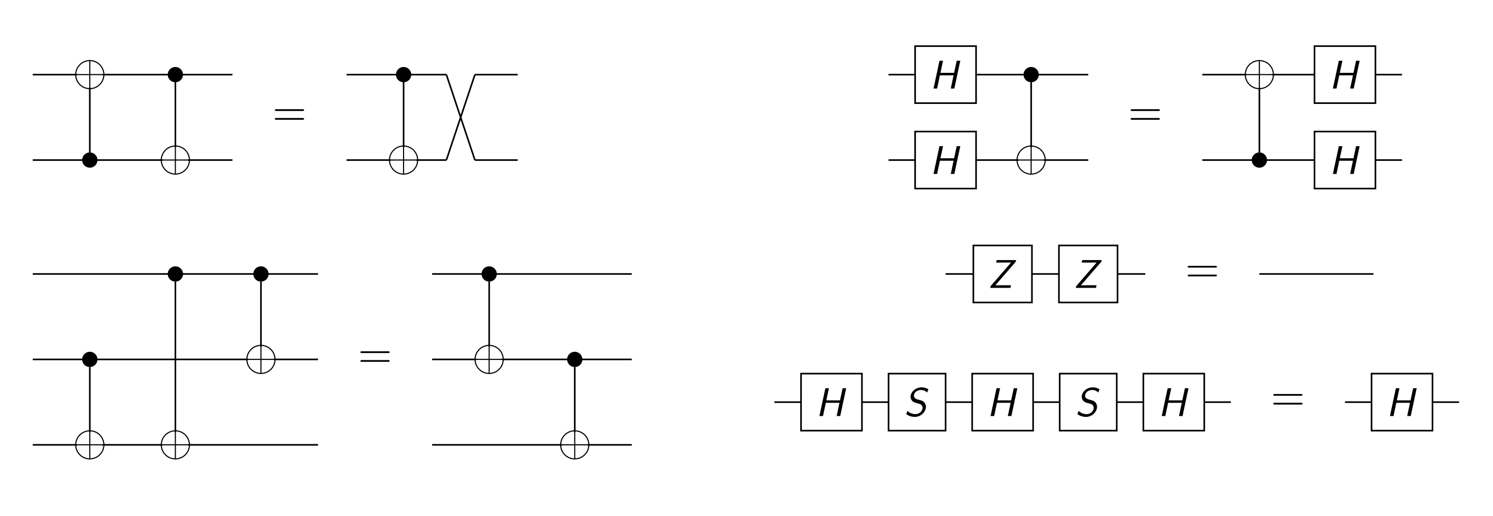
Classical optimization
Why use ZX-Calculus for this?
Circuit simplifications also exist for logic gates:

Slide 7
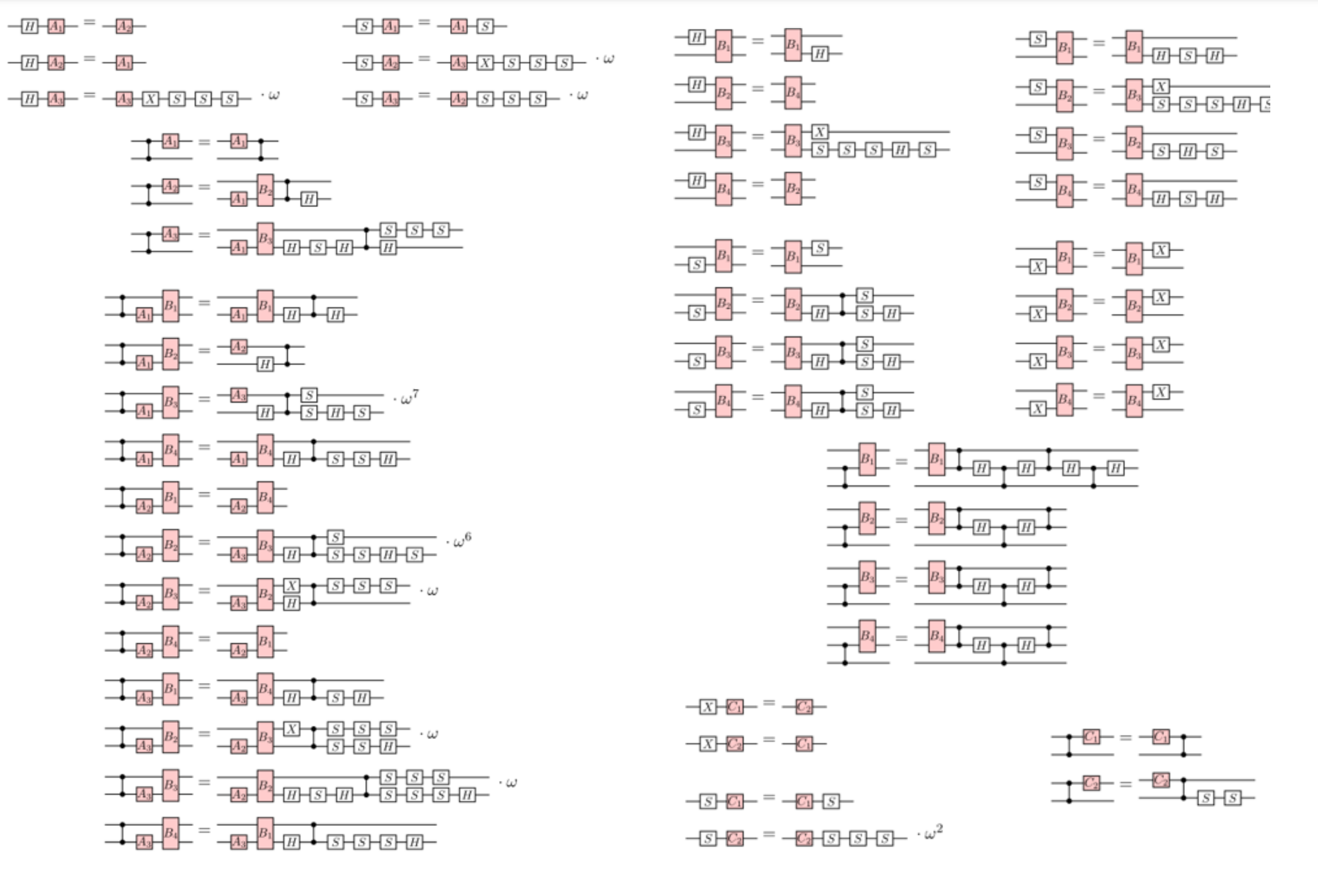
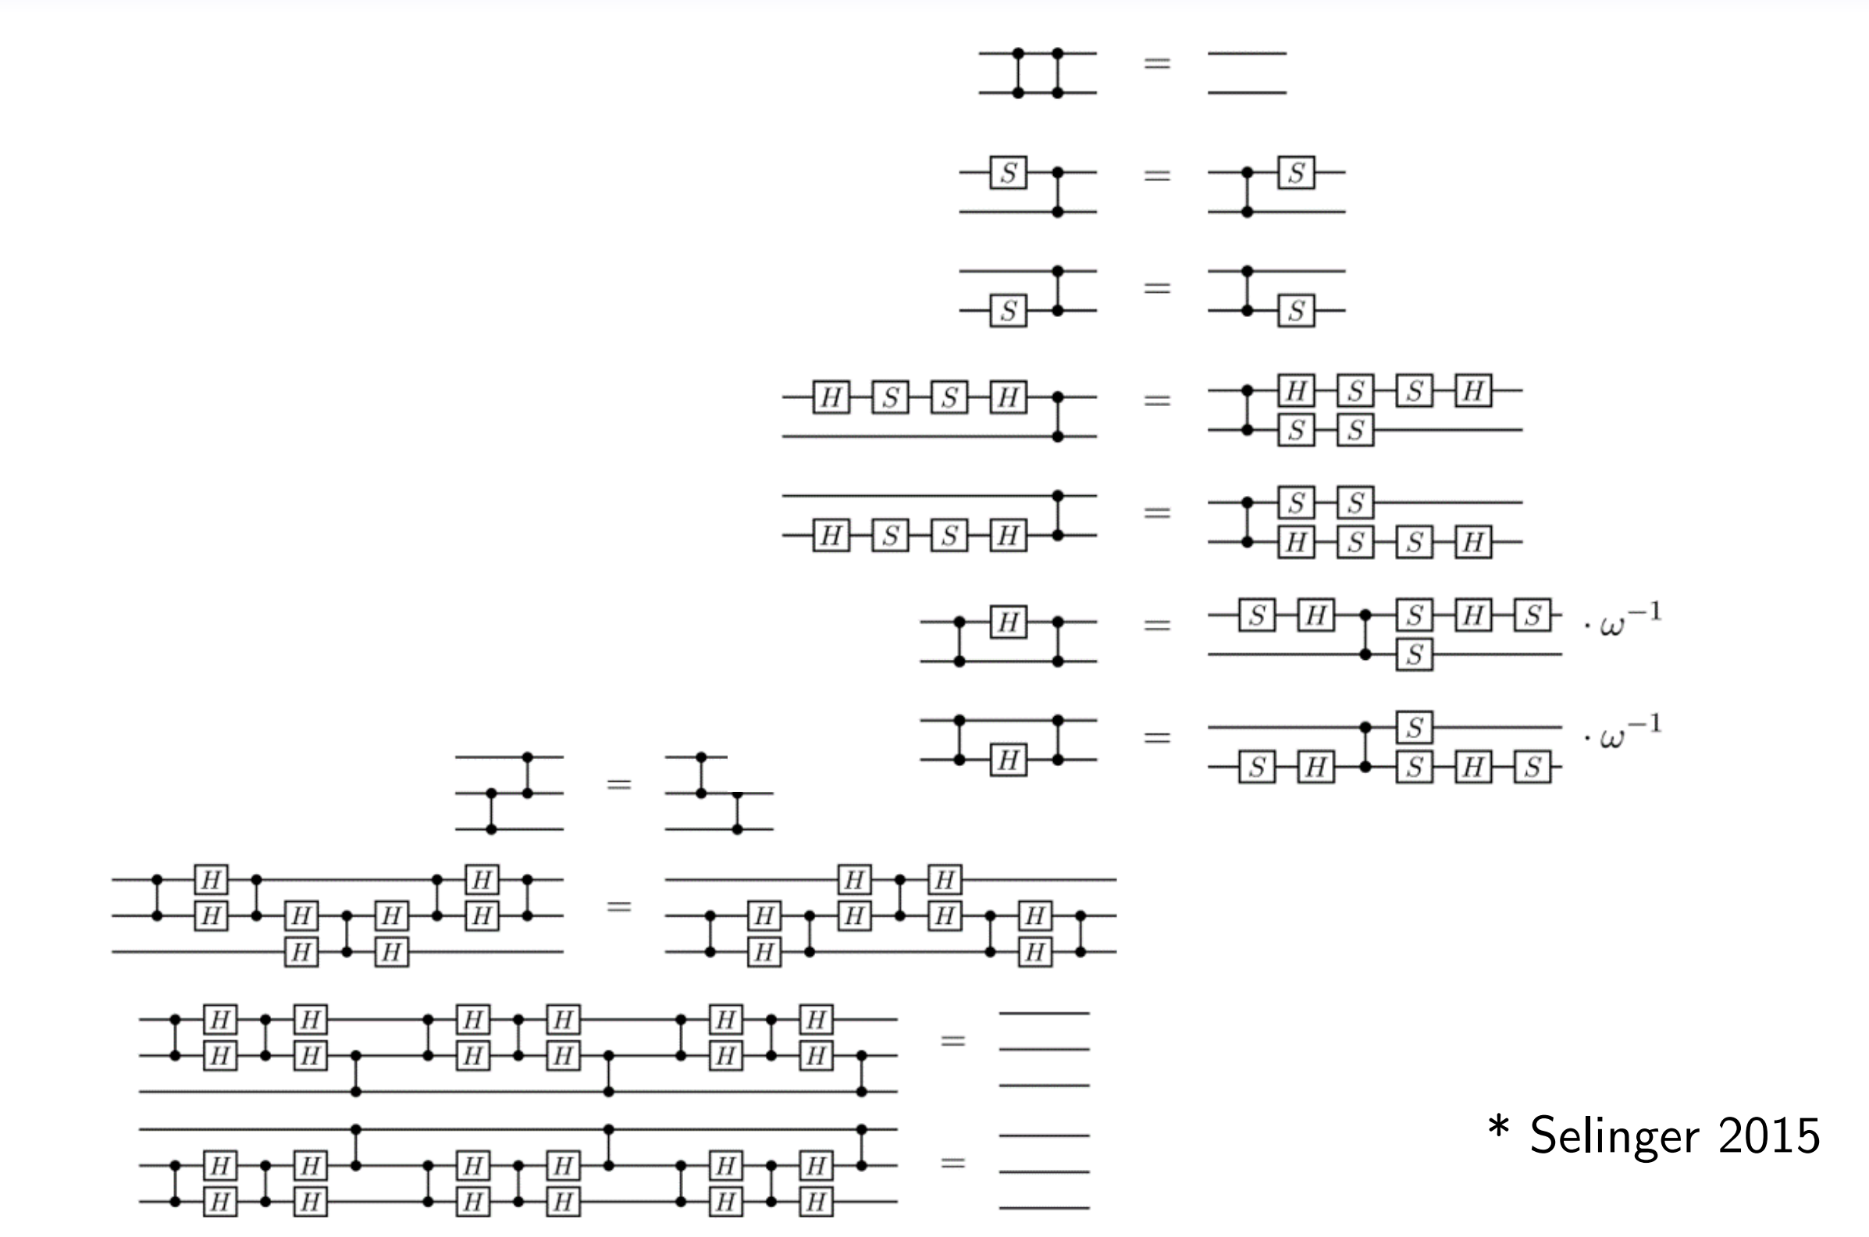
Classical optimization
Unfortunately, there are more …

Slide 8
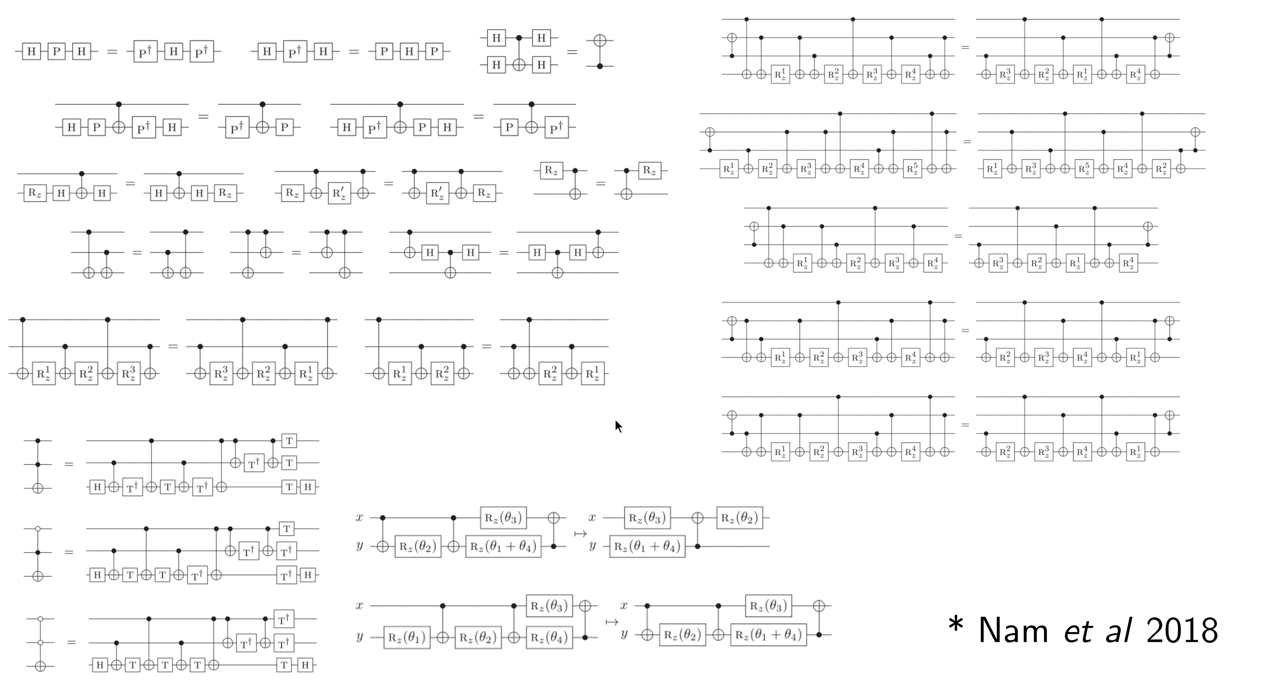
Classical optimization
And more …

Slide 9
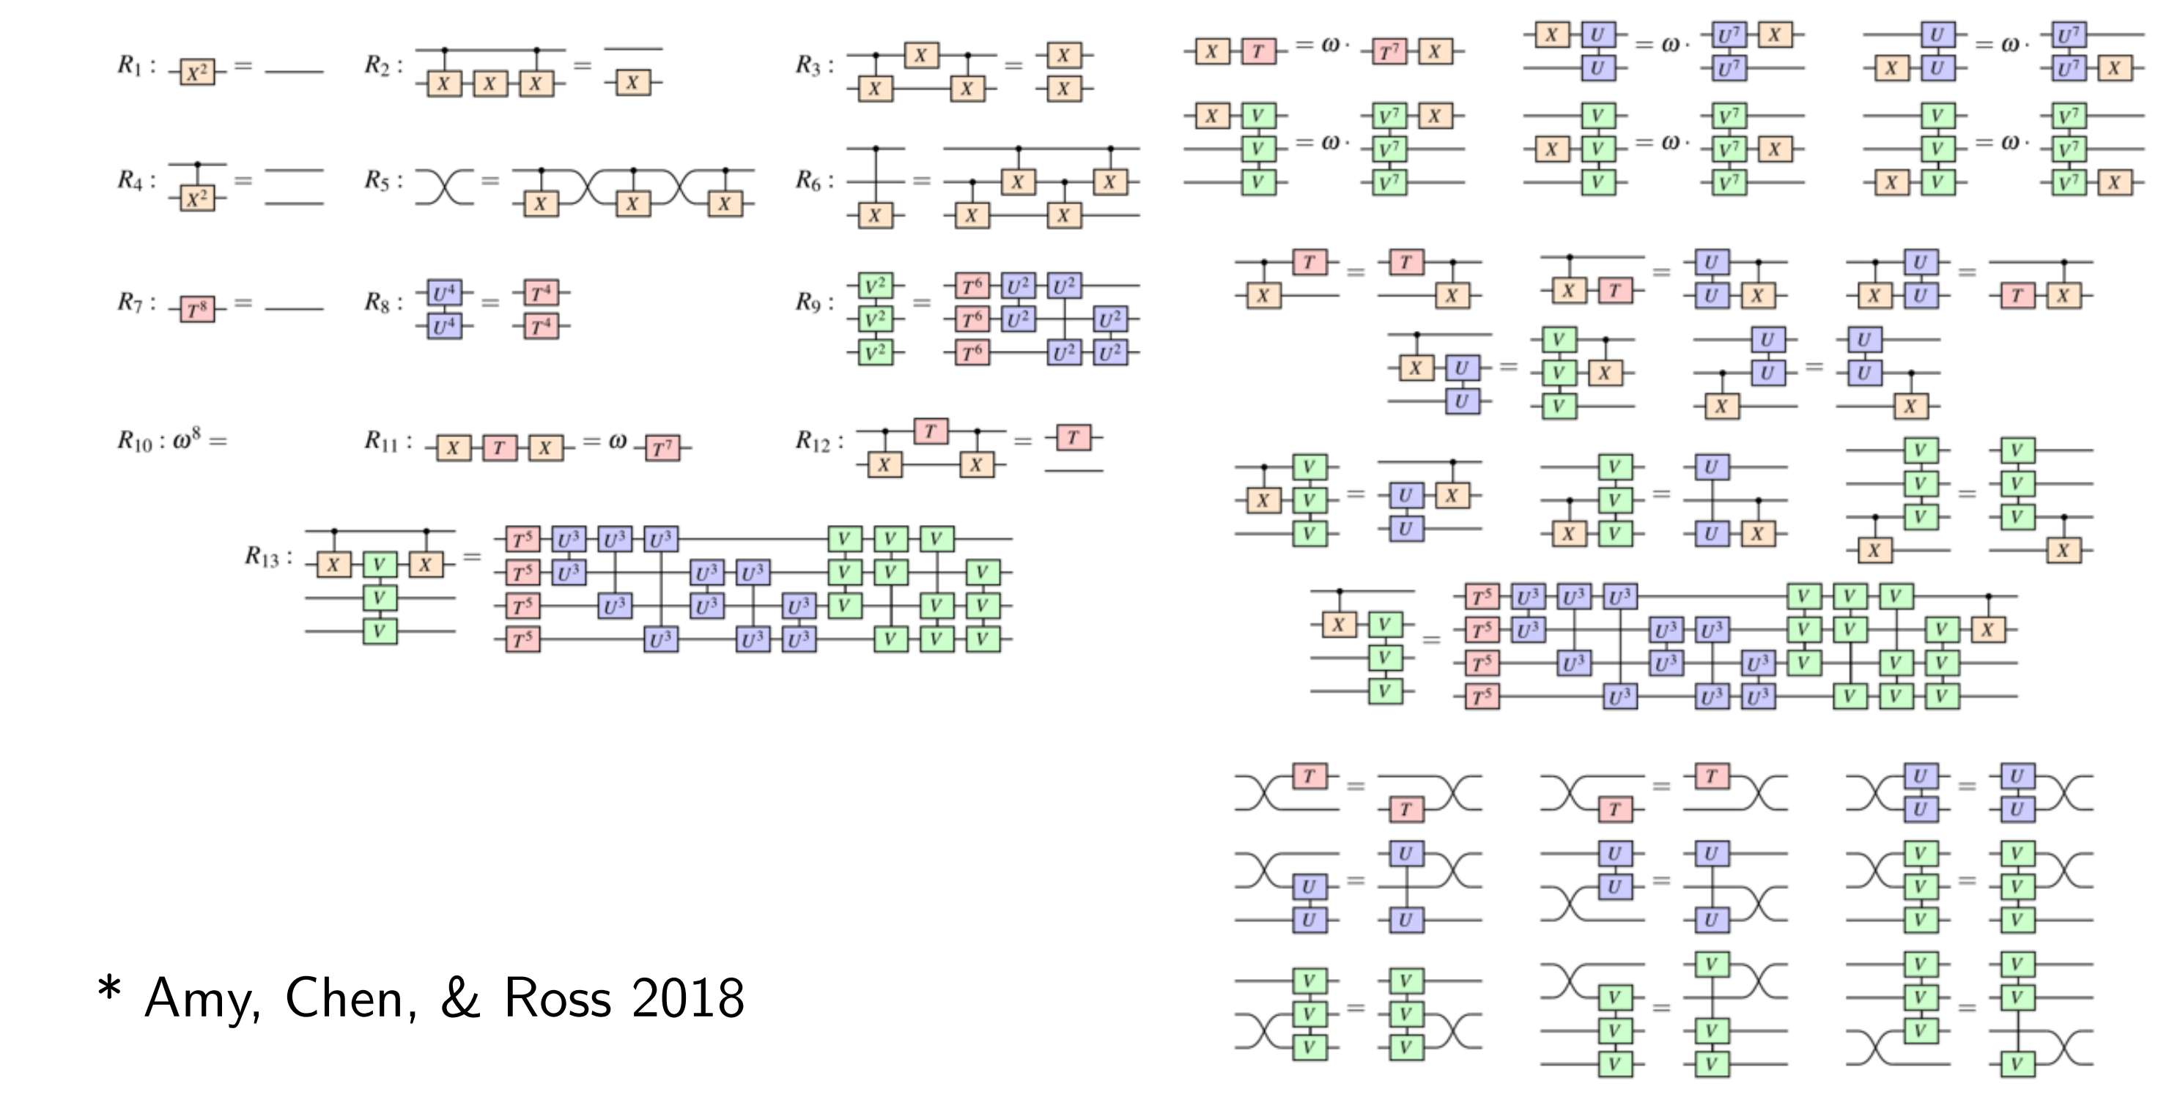
Classical optimization
And even more …

Slide 10
Classical optimization
Optimizing a circuit classically is unpractical
Finding an optimal simplification path is hard
Huge number of identities to consider
ZX-Calculus solves this problem
It has a massively reduced set of simplification rules
Finding the optimal path is still hard, but its manageable

Slide 11
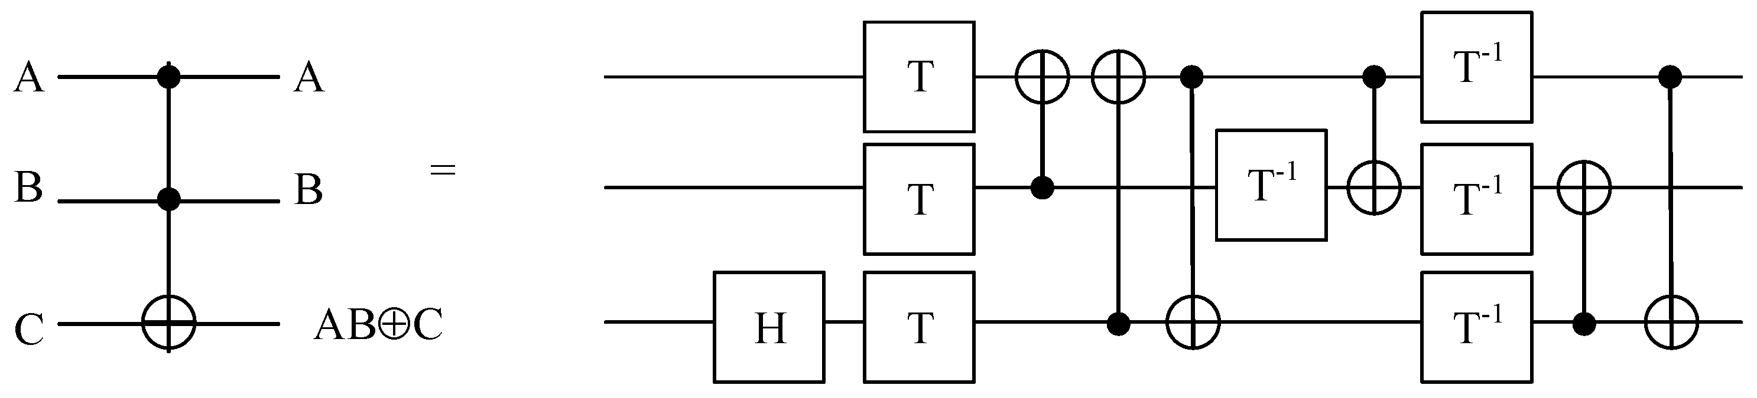
T-Count Optimization
Quantum computers are affected by noise
Clifford+T Circuits can be made tolerant to noise
Problem: Many new T-Gates need to be introduced
Difficult to simulate (Hardware Limits, high latency)
ZX-Calculus can simplify such circuits
Decomposition of a Toffoli Gate: TCount = 7

Slide 12
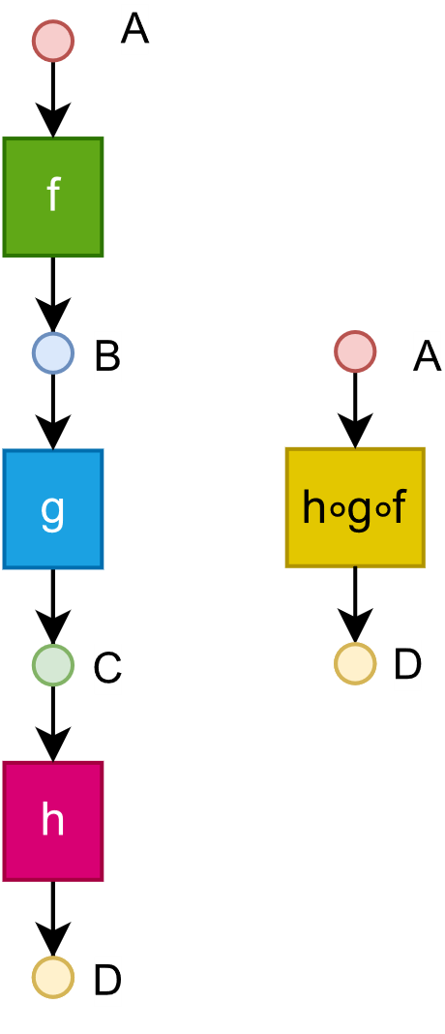
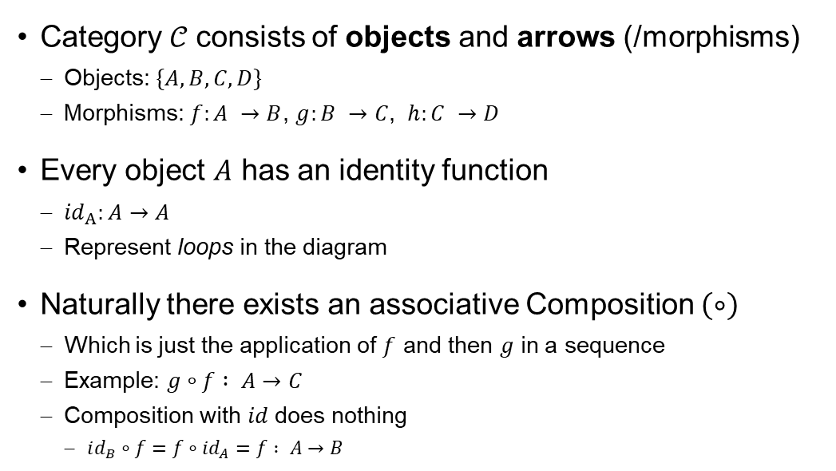

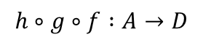
Mathematical Background: Category Theory
Category $𝒞$ consists of objects and arrows (/morphisms)
Objects: $\{A,B,C,D\}$
Morphisms: $f:A →B$, $g:B →C$, $h:C →D$
Every object $A$ has an identity function
${id}_{A}:A→A$
Represent loops in the diagram
Naturally there exists an associative Composition $\left(∘\right)$
Which is just the application of $f$ and then $g$ in a sequence
Example: $g∘f : A→C$
Composition with 𝑖𝑑 does nothing
$id_{B}∘f=f∘id_{A}=f : A→B$
$$=$$
$$h∘g∘f :A→D$$

Slide 13
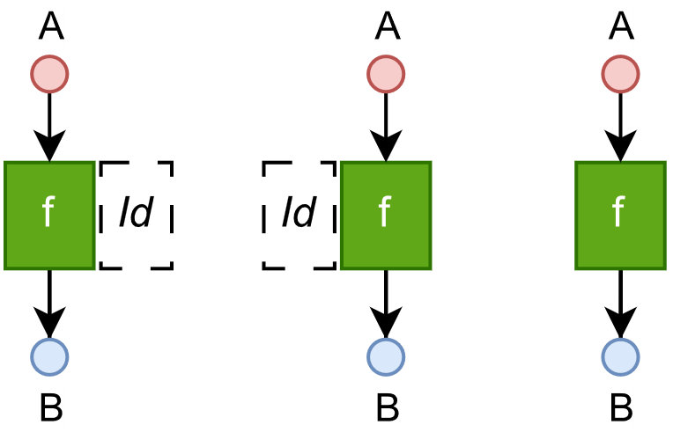
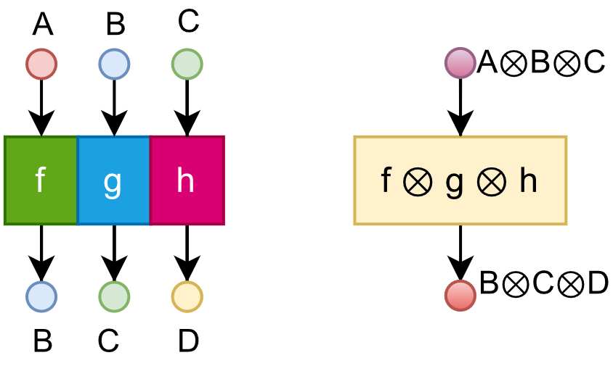


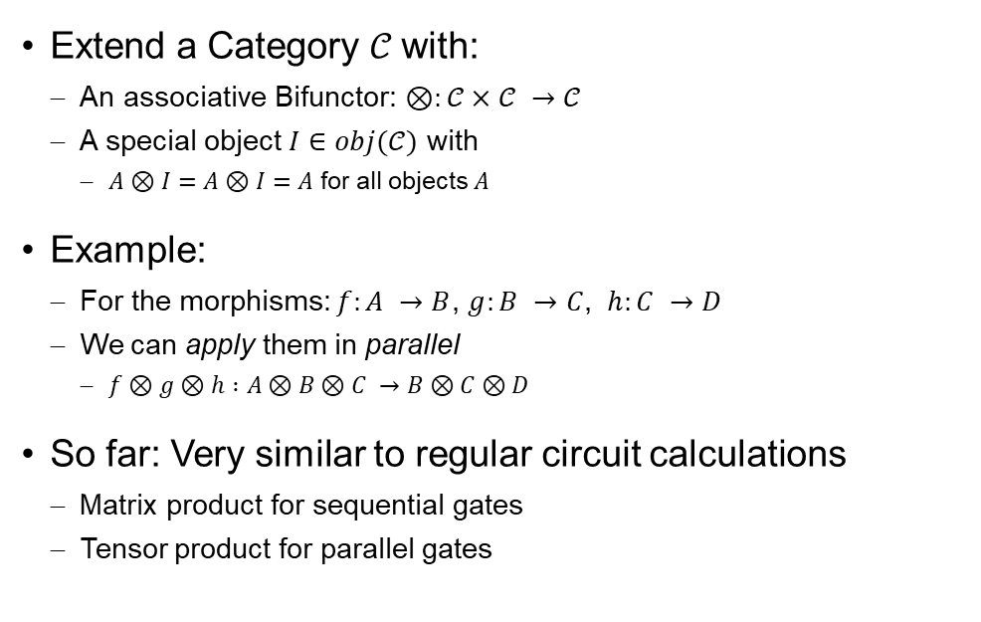

Extension: Monoidal Category
Extend a Category $𝒞$ with:
An associative Bifunctor: $⊗:𝒞×𝒞 →𝒞$
A special object $I∈obj(𝒞)$ with
$A⊗I=A⊗I=A$ for all objects $A$
Example:
For the morphisms: $f:A →B$, $g:B →C$, $h:C →D$
We can apply them in parallel
$f⊗g⊗h :A⊗B⊗C →B⊗C⊗D$
So far: Very similar to regular circuit calculations
Matrix product for sequential gates
Tensor product for parallel gates
$$=$$
$$=$$
$$=$$

Slide 14
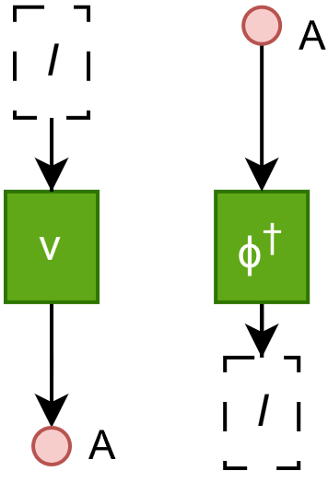
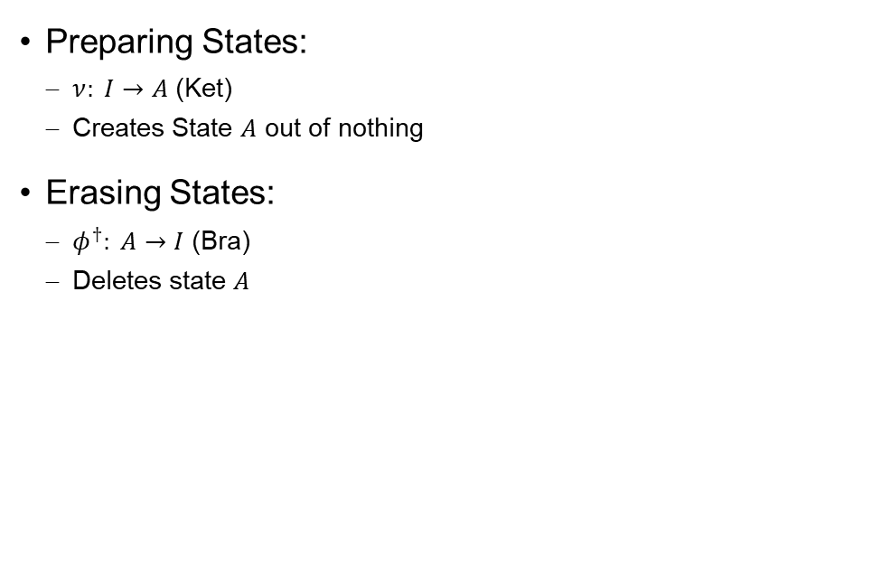
Special morphisms in Monoidal Categories
Preparing States:
$ν: I→A$ (Ket)
Creates State $A$ out of nothing
Erasing States:
$φ^{†}: A→I$ (Bra)
Deletes state $A$

Slide 15
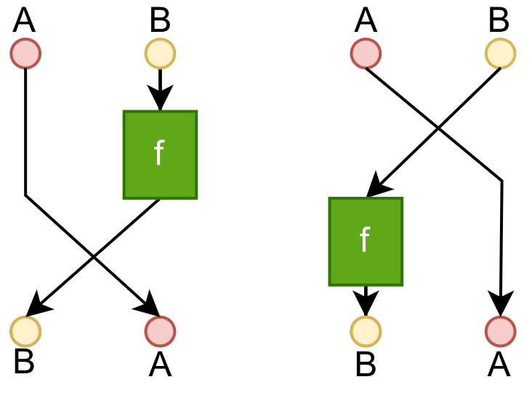
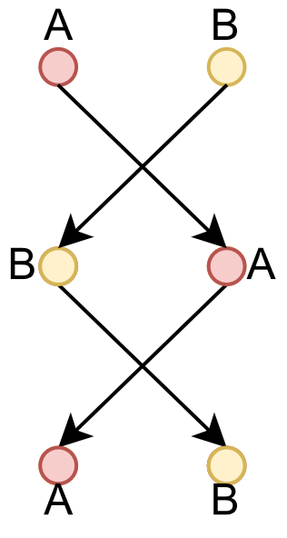

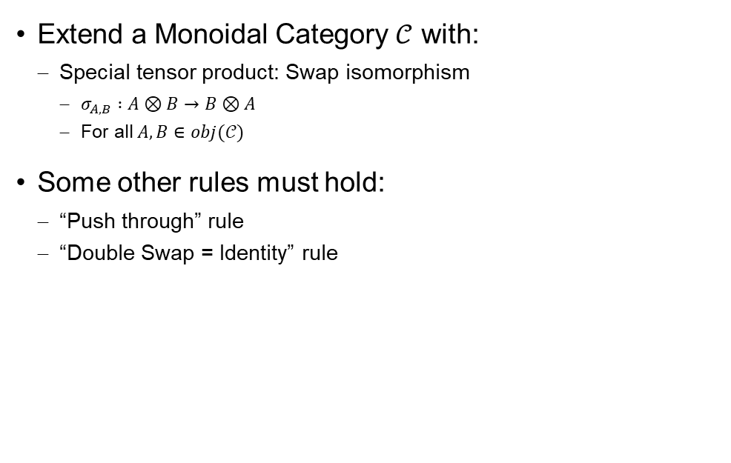
Extension: Symmetric Monoidal Category
Extend a Monoidal Category $𝒞$ with:
Special tensor product: Swap isomorphism
$σ_{A,B} :A⊗B→B⊗A$
For all $A,B∈obj(𝒞)$
Some other rules must hold:
“Push through” rule
“Double Swap = Identity” rule
$$=$$

Slide 16
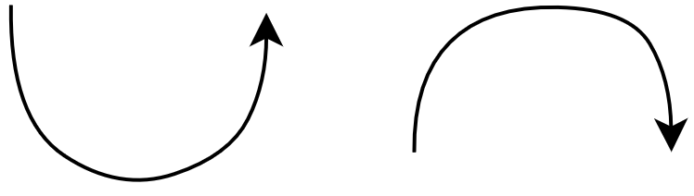
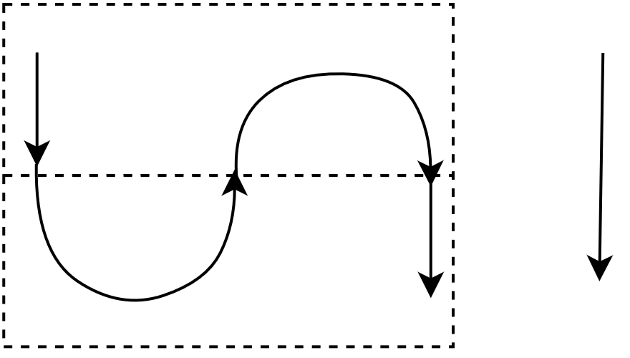

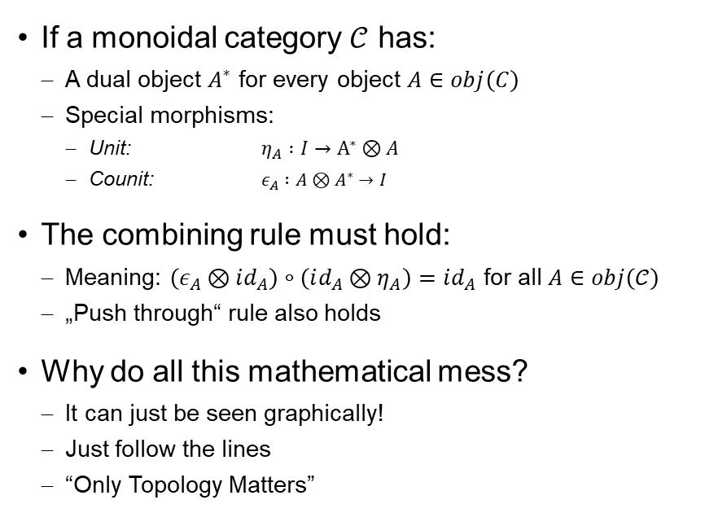

Extension: Compact Monoidal Category
$$ε_{A} :A⊗A^{∗}→I$$
$$η_{A} :I→A^{∗}⊗A$$
If a monoidal category $𝒞$ has:
A dual object $A^{∗}$ for every object $A∈obj\left(C\right)$
Special morphisms:
Unit: $η_{A} :I→A^{∗}⊗A$
Counit: $ε_{A} :A⊗A^{∗}→I$
The combining rule must hold:
Meaning: $\left(ε_{A}⊗id_{A}\right)∘\left(id_{A}⊗η_{A}\right)=id_{A}$ for all $A∈obj\left(𝒞\right)$
„Push through“ rule also holds
Why do all this mathematical mess?
It can just be seen graphically!
Just follow the lines
“Only Topology Matters”
$$A^{∗}$$
$$A$$
$$A^{∗}$$
$$A$$
$$A$$
$$A$$
$$=$$
$$A$$
$$A$$

Slide 17
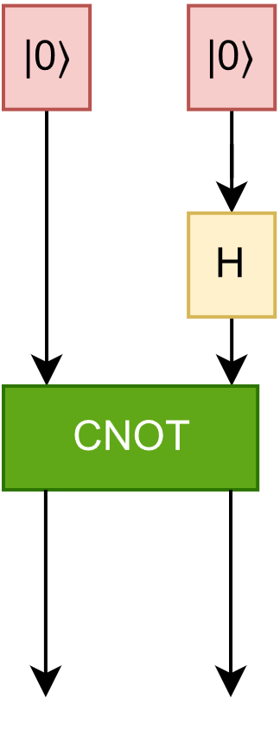
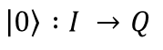
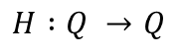
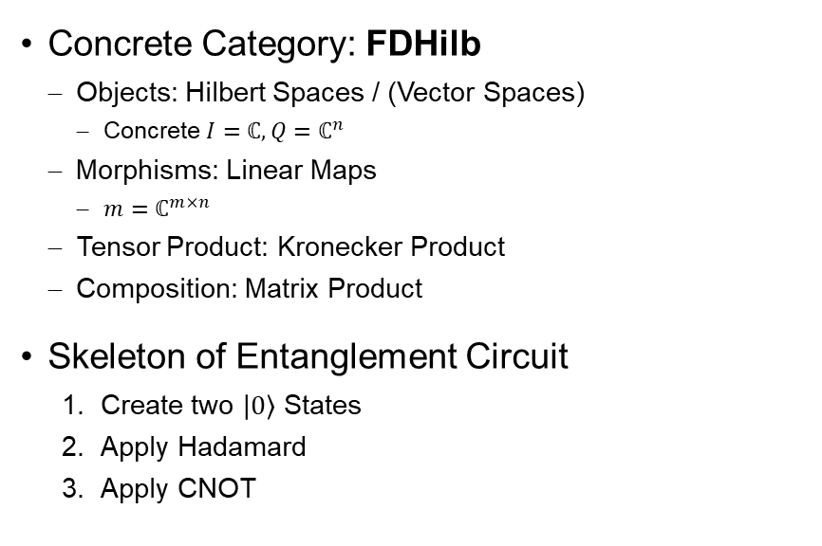
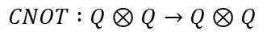
Example Network
Concrete Category: FDHilb
Objects: Hilbert Spaces / (Vector Spaces)
Concrete $I=ℂ, Q=ℂ^{n}$
Morphisms: Linear Maps
$m=ℂ^{m×n}$
Tensor Product: Kronecker Product
Composition: Matrix Product
Skeleton of Entanglement Circuit
Create two $\left|0\right\rangle$ States
Apply Hadamard
Apply CNOT
$$\left|0\right\rangle :I →Q$$
$$H :Q →Q$$
$$CNOT :Q⊗Q→Q⊗Q$$

Slide 18
ZX-Notation
Main idea of ZX-Calculus
Represent quantum circuit visually as network of morphisms
Apply simplifications on the network
“Only topology Matters”
If it looks like the same graph its the same thing
Guaranteed by the rules of the underlying Category
The circuit consists of the atoms of logic gates
We represent this atoms using spiders
Spiders represent the morphisms from before

Slide 19
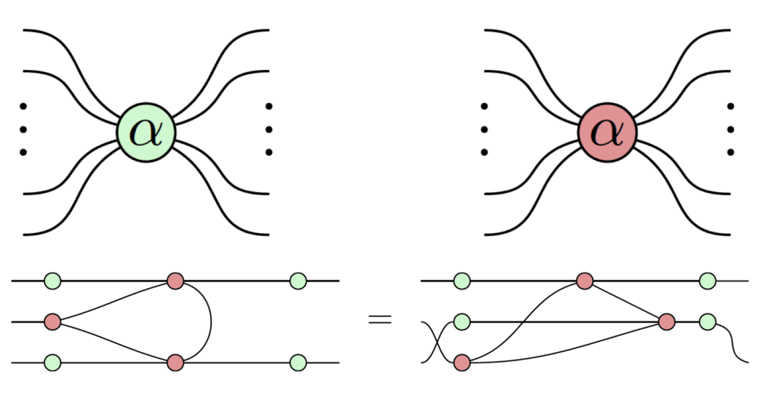
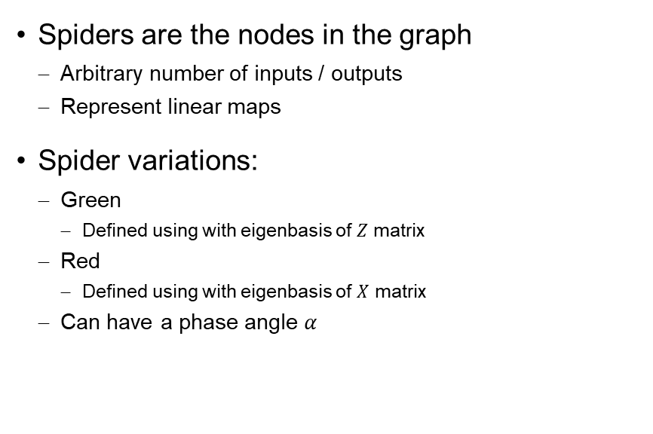
Spiders
Spiders are the nodes in the graph
Arbitrary number of inputs / outputs
Represent linear maps
Spider variations:
Green
Defined using with eigenbasis of $Z$ matrix
Red
Defined using with eigenbasis of $X$ matrix
Can have a phase angle $α$

Slide 20
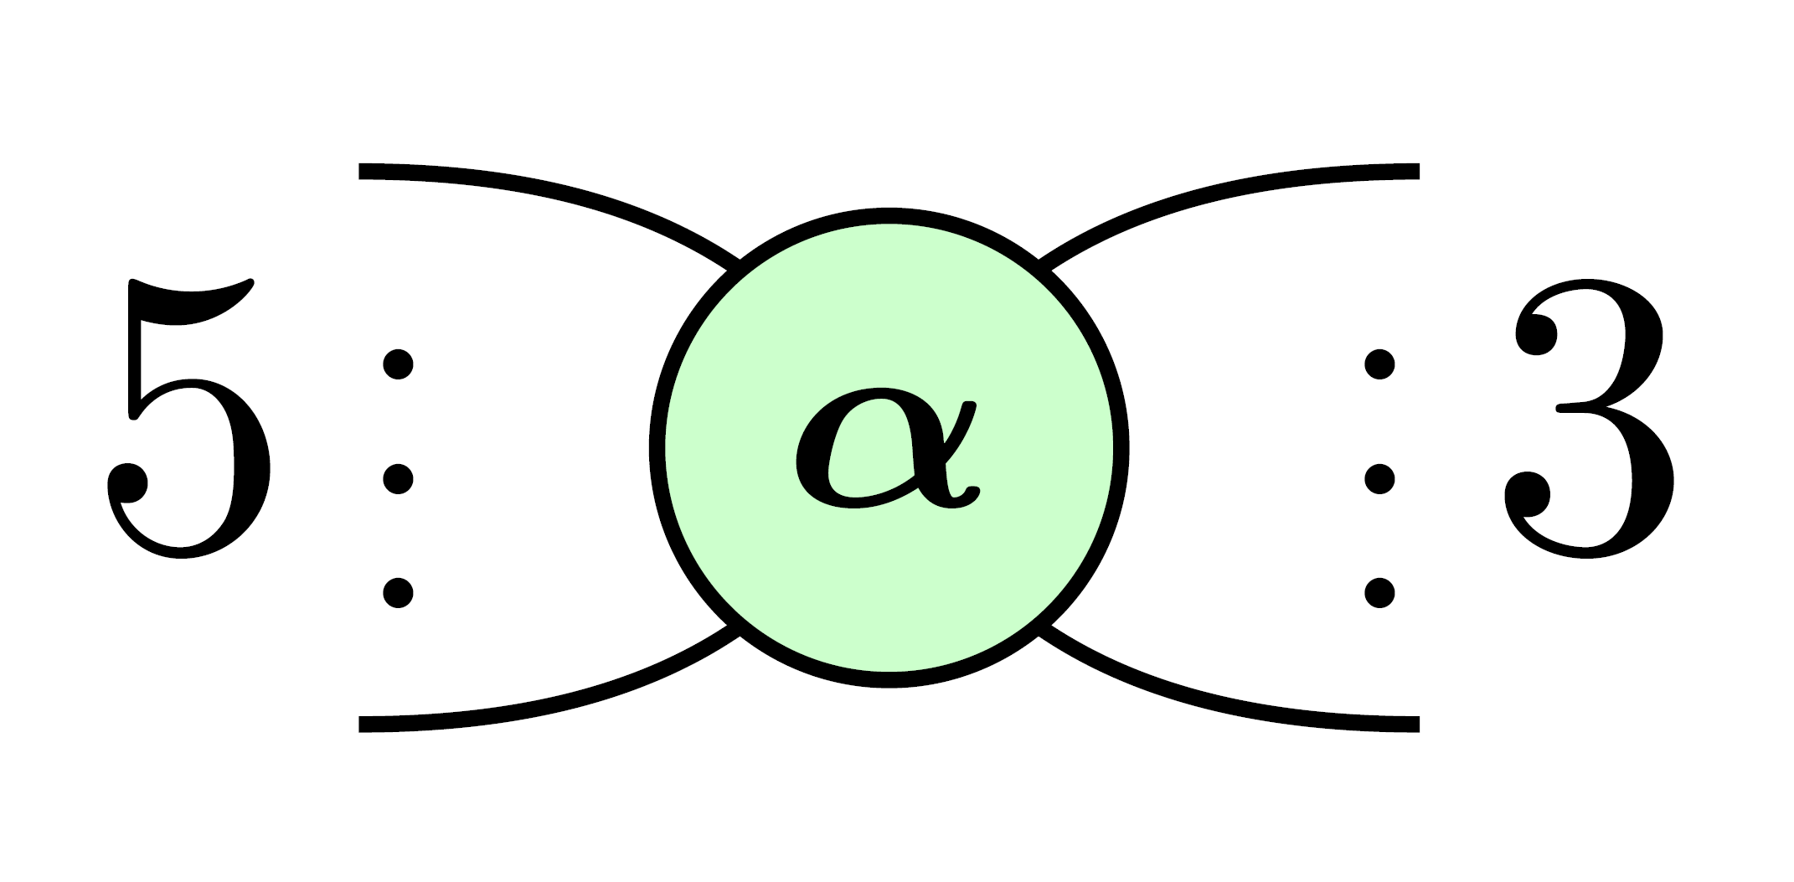
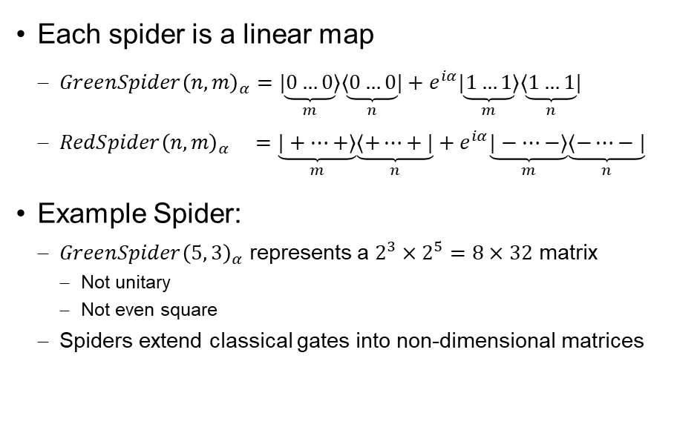
Spiders as linear maps
Each spider is a linear map
$GreenSpider{\left(n,m\right)}_{α}=\underset{m}{\underbrace{|0…0⟩}}\underset{n}{\underbrace{⟨0…0|}} +e^{iα}\underset{m}{\underbrace{|1…1⟩}}\underset{n}{\underbrace{⟨1…1|}}$
$RedSpider{\left(n,m\right)}_{α} =\underset{m}{\underbrace{|+…+⟩}}\underset{n}{\underbrace{⟨+…+|}} +e^{iα}\underset{m}{\underbrace{|−…−⟩}}\underset{n}{\underbrace{⟨−…−|}}$
Example Spider:
$GreenSpider{\left(5, 3\right)}_{α}$ represents a $2^{3}×2^{5}=8×32$ matrix
Not unitary
Not even square
Spiders extend classical gates into non-dimensional matrices

Slide 21
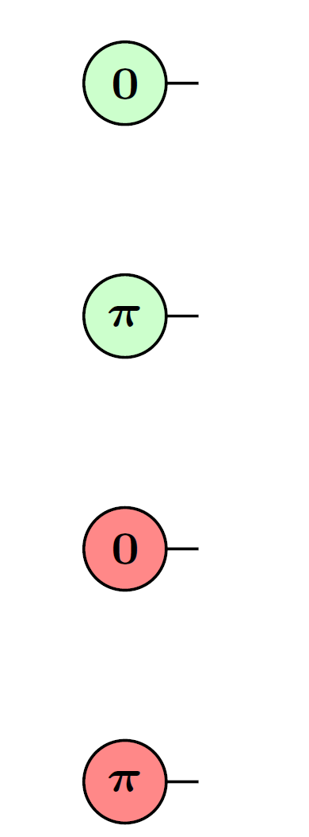
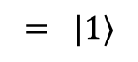
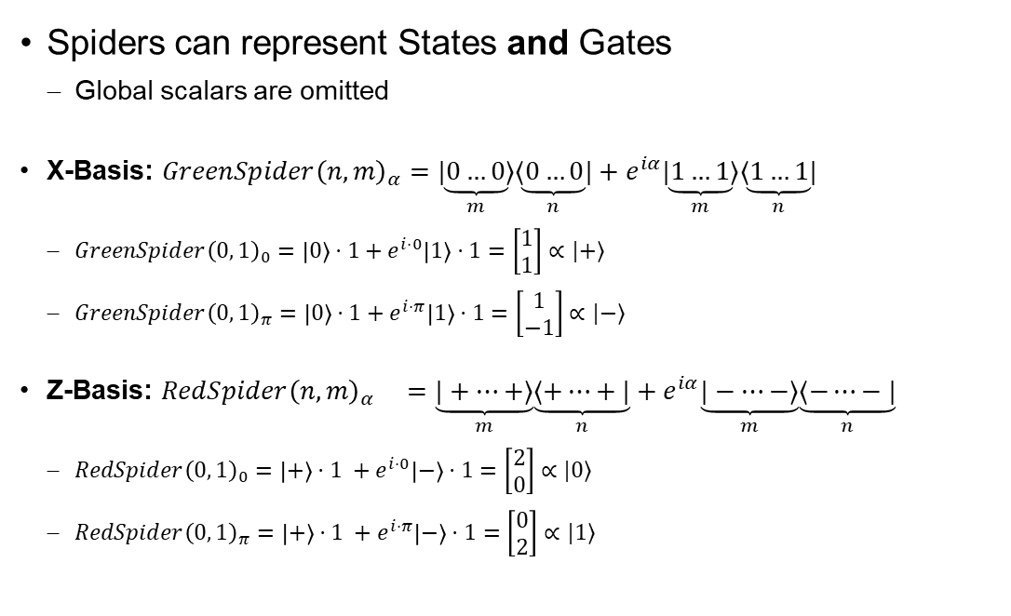
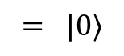
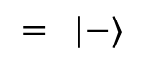
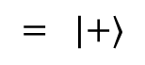
Spiders for Basis States
Spiders can represent States and Gates
Global scalars are omitted
X-Basis: $GreenSpider{\left(n,m\right)}_{α}=\underset{m}{\underbrace{|0…0⟩}}\underset{n}{\underbrace{⟨0…0|}} +e^{iα}\underset{m}{\underbrace{|1…1⟩}}\underset{n}{\underbrace{⟨1…1|}}$
$GreenSpider{\left(0, 1\right)}_{0}=\left|0\right\rangle ⋅1+e^{i⋅0}\left|1\right\rangle ⋅1=\left[\begin{matrix}1 \\ 1\end{matrix}\right]∝|+⟩$
$GreenSpider{\left(0, 1\right)}_{π}=\left|0\right\rangle ⋅1+e^{i⋅π}\left|1\right\rangle ⋅1=\left[\begin{matrix}1 \\ −1\end{matrix}\right]∝|−⟩$
Z-Basis: $RedSpider{\left(n,m\right)}_{α} =\underset{m}{\underbrace{|+…+⟩}}\underset{n}{\underbrace{⟨+…+|}} +e^{iα}\underset{m}{\underbrace{|−…−⟩}}\underset{n}{\underbrace{⟨−…−|}}$
$RedSpider{\left(0, 1\right)}_{0}=\left|+\right\rangle ⋅1 +e^{i⋅0}\left|−\right\rangle ⋅1=\left[\begin{matrix}2 \\ 0\end{matrix}\right]∝|0⟩$
$RedSpider{\left(0, 1\right)}_{π}=\left|+\right\rangle ⋅1 +e^{i⋅π}\left|−\right\rangle ⋅1=\left[\begin{matrix}0 \\ 2\end{matrix}\right]∝|1⟩$
$$= |+⟩$$
$$= |−⟩$$
$$= |0⟩$$
$$= |1⟩$$

Slide 22
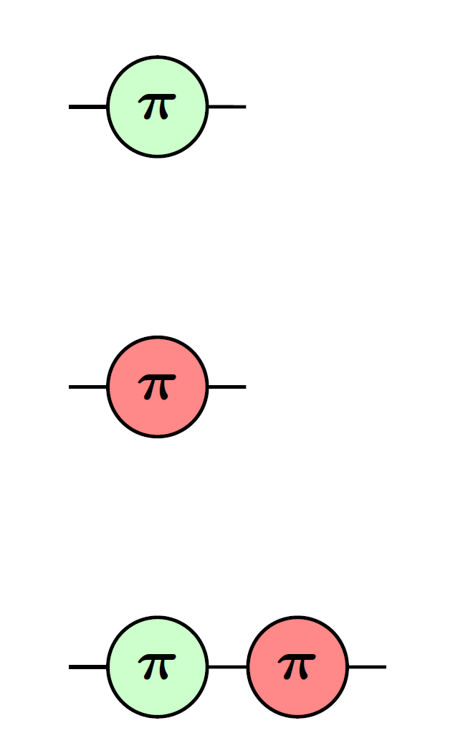
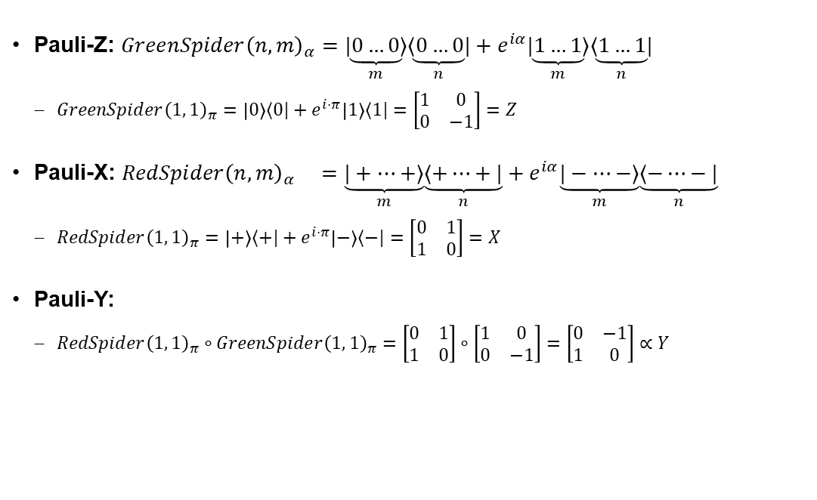



Spiders for Pauli Matrices
Pauli-Z: $GreenSpider{\left(n,m\right)}_{α}=\underset{m}{\underbrace{|0…0⟩}}\underset{n}{\underbrace{⟨0…0|}} +e^{iα}\underset{m}{\underbrace{|1…1⟩}}\underset{n}{\underbrace{⟨1…1|}}$
$GreenSpider{\left(1, 1\right)}_{π}=\left|0\right\rangle ⟨0|+e^{i⋅π}\left|1\right\rangle ⟨1|=\left[\begin{matrix}1 & 0 \\ 0 & −1\end{matrix}\right]=Z$
Pauli-X: $RedSpider{\left(n,m\right)}_{α} =\underset{m}{\underbrace{|+…+⟩}}\underset{n}{\underbrace{⟨+…+|}} +e^{iα}\underset{m}{\underbrace{|−…−⟩}}\underset{n}{\underbrace{⟨−…−|}}$
$RedSpider{\left(1, 1\right)}_{π}=\left|+\right\rangle ⟨+|+e^{i⋅π}\left|−\right\rangle ⟨−|=\left[\begin{matrix}0 & 1 \\ 1 & 0\end{matrix}\right]=X$
Pauli-Y:
$RedSpider{\left(1, 1\right)}_{π}∘GreenSpider{\left(1, 1\right)}_{π}=\left[\begin{matrix}0 & 1 \\ 1 & 0\end{matrix}\right]∘\left[\begin{matrix}1 & 0 \\ 0 & −1\end{matrix}\right]=\left[\begin{matrix}0 & −1 \\ 1 & 0\end{matrix}\right]∝Y$
$$=Z$$
$$=X$$
$$∝Y$$

Slide 23
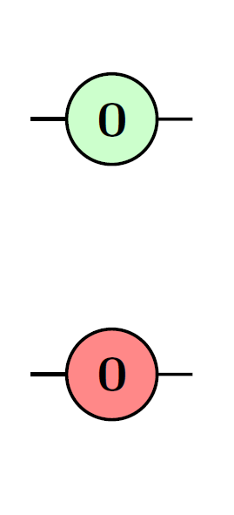
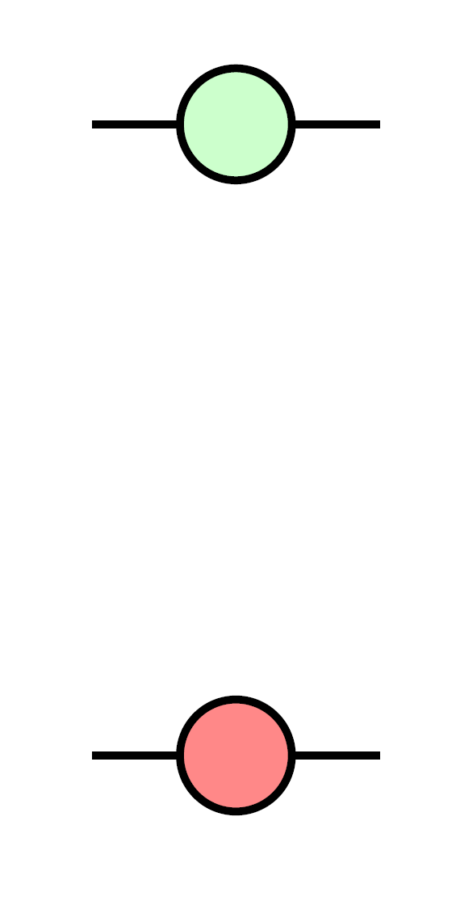
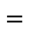
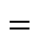
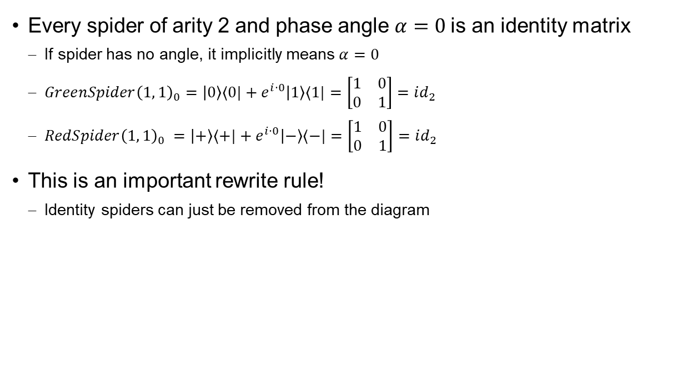
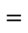
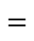
Spider for Identity Matrix
Every spider of arity 2 and phase angle $α=0$ is an identity matrix
If spider has no angle, it implicitly means $α=0$
$GreenSpider{\left(1, 1\right)}_{0}=\left|0\right\rangle ⟨0|+e^{i⋅0}\left|1\right\rangle ⟨1|=\left[\begin{matrix}1 & 0 \\ 0 & 1\end{matrix}\right]=id_{2}$
$RedSpider{\left(1, 1\right)}_{0} =\left|+\right\rangle ⟨+|+e^{i⋅0}\left|−\right\rangle ⟨−|=\left[\begin{matrix}1 & 0 \\ 0 & 1\end{matrix}\right]=id_{2}$
This is an important rewrite rule!
Identity spiders can just be removed from the diagram
$$=$$
$$=$$
$$=$$
$$=$$

Slide 24
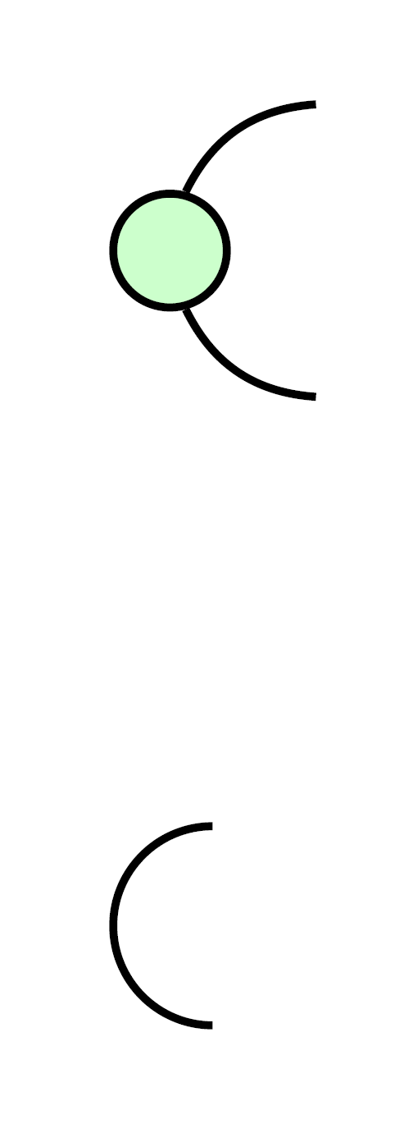
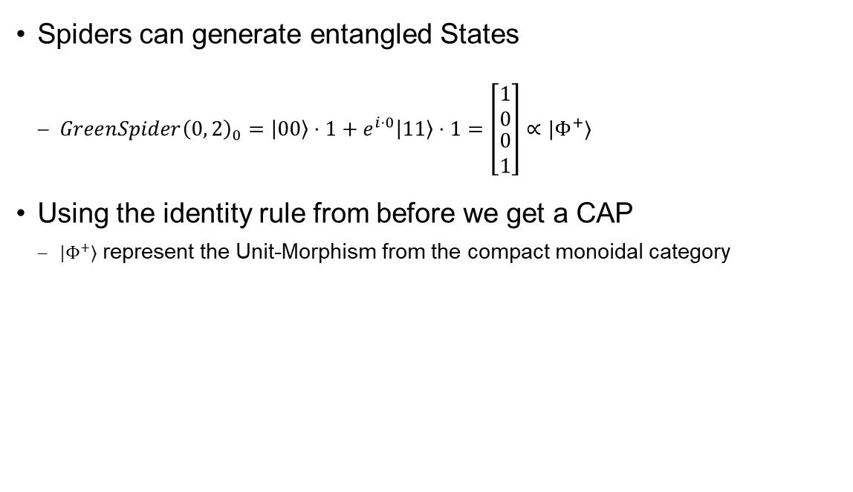
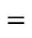
Spider for Bell State
Spiders can generate entangled States
$GreenSpider{\left(0, 2\right)}_{0}=\left|00\right\rangle ⋅1+e^{i⋅0}\left|11\right\rangle ⋅1=\left[\begin{matrix}\begin{matrix}1 \\ 0\end{matrix} \\ 0 \\ 1\end{matrix}\right]∝|Φ^{+}⟩$
Using the identity rule from before we get a CAP
$|Φ^{+}⟩$ represent the Unit-Morphism from the compact monoidal category
$$=$$

Slide 25

Combining Spiders
Bigger Graphs can be constructed by connecting spiders
Every output of a spider gets connected to the input of another spider
Again: Only Topology matters
The resulting graph can represent a quantum circuit
But not every graph is a valid circuit

Slide 26



Calculating a Graph
To calculate the matrix representation
Divide the graph into regions
Each region must contain exactly one spider
Simplification works just like normal circuits
“parallel” parts are combined using the tensor product
“sequential” parts are combined using the matrix product
The resulting matrix represents the circuit
It is not necessary square / unitary
$$A_{3}$$
$$A_{1}$$
$$A_{2}$$

Slide 27






Example: CNOT
Evaluate parallel Sections
$A=A_{1}⊗A_{2}=id_{2}⊗RedSpider\left(1, 2\right)$
$B=B_{1}⊗B_{1}=GreenSpider\left(2,1\right)⊗id_{2}$
Combine sequential Regions
$CNOT=B∘A$
$$A_{1}$$
$$B_{2}$$
$$A_{2}$$
$$B_{2}$$

Slide 28



Example: CNOT Parallel Sections
$A=id_{2}⊗RedSpider\left(1, 2\right)={id}_{2}⊗\left( | +\right\rangle \left\langle ++ | + \left|−\right\rangle \left\langle −−\right| \right)$
$A=\left[\begin{matrix}1 & 0 \\ 0 & 1\end{matrix}\right]⊗\frac{1}{\sqrt{2}}\left[\begin{matrix}1 & 0 \\ 0 & 1 \\ \begin{matrix}0 \\ 1\end{matrix} & \begin{matrix}1 \\ 0\end{matrix}\end{matrix}\right]=\frac{1}{\sqrt{2}}\left[\begin{matrix}\begin{matrix}1 & 0 \\ 0 & 1 \\ \begin{matrix}0 \\ 1\end{matrix} & \begin{matrix}1 \\ 0\end{matrix}\end{matrix} & \begin{matrix}0 & 0 \\ 0 & 0 \\ \begin{matrix}0 \\ 0\end{matrix} & \begin{matrix}0 \\ 0\end{matrix}\end{matrix} \\ \begin{matrix}0 & 0 \\ 0 & 0 \\ \begin{matrix}0 \\ 0\end{matrix} & \begin{matrix}0 \\ 0\end{matrix}\end{matrix} & \begin{matrix}1 & 0 \\ 0 & 1 \\ \begin{matrix}0 \\ 1\end{matrix} & \begin{matrix}1 \\ 0\end{matrix}\end{matrix}\end{matrix}\right]$
$B=GreenSpider\left(2,1\right)⊗id_{2}=\left( | 00\right\rangle \left\langle 0 | + \left|11\right\rangle \left\langle 1\right| \right)⊗id_{2}$
$B=\left[\begin{matrix}1 & 0 & \begin{matrix}0 & 0\end{matrix} \\ 0 & 0 & \begin{matrix}0 & 1\end{matrix}\end{matrix}\right]⊗\left[\begin{matrix}1 & 0 \\ 0 & 1\end{matrix}\right]=\left[\begin{matrix}\begin{matrix}1 & 0 \\ 0 & 1\end{matrix} & \begin{matrix}0 & 0 \\ 0 & 0\end{matrix} & \begin{matrix}\begin{matrix}0 & 0 \\ 0 & 0\end{matrix} & \begin{matrix}0 & 0 \\ 0 & 0\end{matrix}\end{matrix} \\ \begin{matrix}0 & 0 \\ 0 & 0\end{matrix} & \begin{matrix}0 & 0 \\ 0 & 0\end{matrix} & \begin{matrix}0 & 0 & \begin{matrix}1 & 0\end{matrix} \\ 0 & 0 & \begin{matrix}0 & 1\end{matrix}\end{matrix}\end{matrix}\right]$
$$A$$
$$B$$

Slide 29


Example: CNOT Sequential Sections
$R=B∘A$
$R=\left[\begin{matrix}\begin{matrix}1 & 0 \\ 0 & 1\end{matrix} & \begin{matrix}0 & 0 \\ 0 & 0\end{matrix} & \begin{matrix}\begin{matrix}0 & 0 \\ 0 & 0\end{matrix} & \begin{matrix}0 & 0 \\ 0 & 0\end{matrix}\end{matrix} \\ \begin{matrix}0 & 0 \\ 0 & 0\end{matrix} & \begin{matrix}0 & 0 \\ 0 & 0\end{matrix} & \begin{matrix}0 & 0 & \begin{matrix}1 & 0\end{matrix} \\ 0 & 0 & \begin{matrix}0 & 1\end{matrix}\end{matrix}\end{matrix}\right]∘\frac{1}{\sqrt{2}}\left[\begin{matrix}\begin{matrix}1 & 0 \\ 0 & 1 \\ \begin{matrix}0 \\ 1\end{matrix} & \begin{matrix}1 \\ 0\end{matrix}\end{matrix} & \begin{matrix}0 & 0 \\ 0 & 0 \\ \begin{matrix}0 \\ 0\end{matrix} & \begin{matrix}0 \\ 0\end{matrix}\end{matrix} \\ \begin{matrix}0 & 0 \\ 0 & 0 \\ \begin{matrix}0 \\ 0\end{matrix} & \begin{matrix}0 \\ 0\end{matrix}\end{matrix} & \begin{matrix}1 & 0 \\ 0 & 1 \\ \begin{matrix}0 \\ 1\end{matrix} & \begin{matrix}1 \\ 0\end{matrix}\end{matrix}\end{matrix}\right]=\frac{1}{\sqrt{2}}\left[\begin{matrix}\begin{matrix}1 & 0 \\ 0 & 1\end{matrix} & \begin{matrix}0 & 0 \\ 0 & 0\end{matrix} \\ \begin{matrix}0 & 0 \\ 0 & 0\end{matrix} & \begin{matrix}0 & 1 \\ 1 & 0\end{matrix}\end{matrix}\right]∝CNOT$
$$A$$
$$B$$
$$R$$

Slide 30

Where to draw the Regions?
There may exist multiple ways of drawing the regions
Obvious, as you are allowed to move components around
“Only topology matters”
This leads to different matrices in the calculation process
But the final matrices are always equivalent
(neglecting the global scalar factor)
But why do it this way?
It is just as bad as the classical matrix approach

Slide 31

Simplification Rules
We don’t want to calculate the graph using its matrix form
There exist many rules to simplify ZX-Graphs
But far fewer rules as for classical circuits
We can apply the rules anywhere in the graph if:
The pattern for the substitution matches
The order of the input / output wires of regions are unchanged
All rule still holds if the spiders flip colors

Slide 32

Spider Fusion
Idea: Two spiders of the same color fuse together
Phase angles add up
Can simplify graph a lot
This rule allows to freely change input and outputs!
Only topology matters

Slide 33

Hopf Rule
Idea: If two spiders of different color are connected by 2 lines, both lines can be deleted

Slide 34


Basis-State Copy Rules
Idea: “Green copies Red”, “Red copies Green”
Only works for computational basis states
$\left|0\right\rangle , |1⟩$ / $\left|+\right\rangle , |−⟩$ depending on colors

Slide 35



Bi-Algebra Rule
Analog to digital logic
Create XOR using spider fusion
Use Copy-Rule from before

Slide 36


$π$-Commutation
Idea: A spider with angle $π$ copy through a spider of opposite color
The phase of the other spider gets flipped

Slide 37

Color Change Rule
Idea: We can change the color of a single spider
But we need to add Hadamard gates to all its inputs / outputs to compensate
Analog: A Hadamard Gate can push through a spider
By copying itself to every other output

Slide 38

Hadamard Gate
Hadamard Gates can be constructed using euler angles
Set up Hadamard as sequence of rotations

Slide 39



Hadamard Gate Cancelation
H
H
Two Hadamard Gates should cancel!
Using a visual proof, we see that the rule holds
(Translate to ZX)
(Spider-Fusion)
($π$-Commutation)
(Spider-Fusion)
(Identity-Removal)
(Spider-Fusion)
(Modulo)
(Identity-Removal)

Slide 40


Example CNOT Application: Control = $\left|0\right\rangle$
As expected:
$|0⟩$ Qubit passes through
Target qubit is untouched

Slide 41


Example CNOT Application: Control = $\left|1\right\rangle$
As expected:
$|1⟩$ Qubit passes through
Pauli X gate is applied to target qubit

Slide 42

Simplification: Three CNOTs
Circuit containing 3 alternating CNOTS

Slide 43

Simplification: Three CNOTs
Transform into ZX-Diagram
Remember CNOT Gate from earlier

Slide 44

Simplification: Three CNOTs
Apply the bi-algebra rule
We need to morph the graph first!

Slide 45

Simplification: Three CNOTs
Morph the ZX-Diagram
Allowed, since we are allowed to move stuff freely
Guaranteed by underlying category

Slide 46

Simplification: Three CNOTs
Apply spider fusion rule
Attention, two wires remain between the first nodes!

Slide 47

Simplification: Three CNOTs
Apply the Hopf-Law

Slide 48

Simplification: Three CNOTs
Identity Removal

Slide 49
Simplification: Three CNOTs
Complicated CNOT circuit is actually a swap operation
Since we are working at the atom-level many other circuits can be simplified like this
Extracting back quantum circuits is hard
But it's possible for simple circuits
(In general: Graph needs to have “gFlow”)

Slide 50



Translating Circuits
Challenge: Try to prove this identity!

Slide 51


From Quantum Circuits to ZX-Diagrams
Example Circuit:
Custom gates need to be handled separately
Backwards direction also possible

Slide 52


Example Circuit Simplification GHZ-State
$\left|GHZ\right\rangle =\frac{\left|000\right\rangle +\left|111\right\rangle }{\sqrt{2}}$
Calculating the circuit with ZX seems trivial compared to classical reasoning
$GreenSpider\left(0, 3\right)=1⋅\left|000\right\rangle +e^{i⋅0}⋅1⋅\left|111\right\rangle =\left|000\right\rangle +\left|111\right\rangle$

Slide 53

Quantum Teleportation

Slide 54

Quantum Teleportation
Shared Bell State, is just a bent wire!
Measurement is a parameterized spider

Slide 55

Toffoli Gate
Toffoli gate calculates a “quantum-AND” between two states
We introduced a new Generator: A “H-Box” to simplify the circuit. (Normally it has 25 Spiders)

Slide 56


Toffoli Gate
Toffoli Gate applied to $|11⟩$

Slide 57

Completeness
ZX Calculus is complete
Any two ZX-Graphs for the same Quantum circuit can be transformed into each other
By just using the rules from before!
This means that if a simpler circuit exists, it can be found using ZX-calculus
But the path between those transformations may traverse invalid quantum circuits

Slide 58
External Image Sources
Quantum compilation [P.4]: https://quantum-journal.org/papers/q-2020-06-04-279/
Circuit optimization [P.5]: https://quantum-journal.org/papers/q-2020-06-04-279/
Circuit Identities: [P.6 - P9]: https://arxiv.org/pdf/1310.6813.pdf
Spiders as Matrix [P.20]: https://zxcalculus.com/tutorial
CNOT ZX-Graph [P.27]: https://commons.wikimedia.org/wiki/File:ZX-calculus_cNOT-example.svg
Example Circuit Identities [P.30]: https://www.arxiv-vanity.com/papers/2303.08829/
Spider Fusion [P.32]: https://www.cs.ox.ac.uk/people/bob.coecke/ZX-lectures_JPG.pdf
CNOT Application [P.40 – P.41]: https://quantumcomputing.stackexchange.com/questions/10235/explain-the-representation-of-the-cnot-gate-in-zx-calculus
CNOT Simplification [P.43 – P.48]: https://zxcalculus.com/
Translating from Gates to ZX [P.50], Example Circuit [P.51]: https://arxiv.org/pdf/2012.13966.pdf
GHZ State Simplification [P.52]: https://medium.com/quantinuum/how-zx-calculus-reveals-the-logic-and-processes-of-quantum-mechanics-to-everyone-944fc3bbbb2c
Teleportation, Toffoli Gate Examples [P.53 – P.56]: https://pennylane.ai/qml/demos/tutorial_zx_calculus
Completeness [P.57]: https://arxiv.org/pdf/1902.03178.pdf

